Slide 1
LandScope America
www.landscope.org
Collaboration between NatureServe and the National Geographic Society
Online resource of maps, data, photos, and stories
NALCC participates in the Landscope Chesapeake effort (www.landscope.org\chesapeake

Slide 2
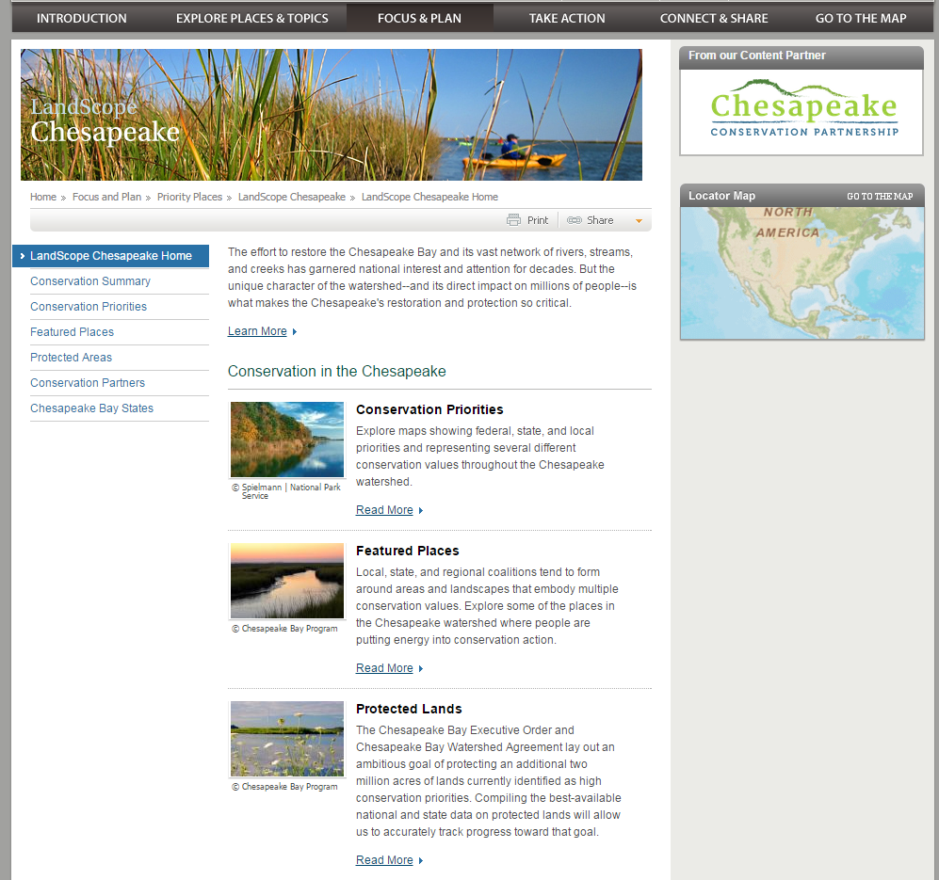
Notes:
And we now have over 100 partners in the region directly involved in the cooperative. Jim Connolly represents the state of Maine, Sharri Venno represents the tribes represents

Slide 3
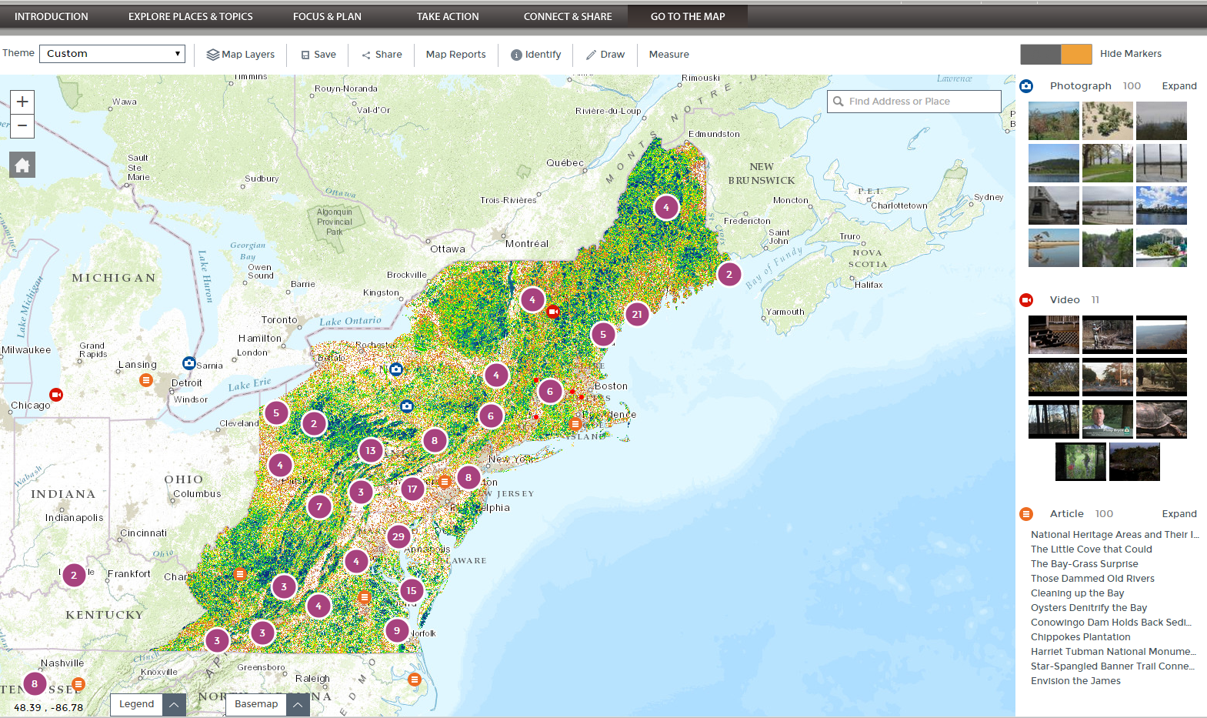
Inter-operability

